Slide 1

Welcome
to the
Training Seminar
on
APQPCP

Slide 2
This program is designed to provide a working knowledge of the Advance Product Quality Planning Process as per the requirements Of QS 9000. This topics should be understood in the broader perspective of a New Product Development rather than as a technique.
The two main requirements of a good Product Development are developing a robust product and developing it in a short time. All the methods discussed in this program are oriented towards these objectives. One of the essential requirements for the success of this approach is the ability to work in teams. Team working is a culture which has to be developed and practiced in the organisation. If we do not adhere to this principle of team working, we may end up without the benefits expected from this process of product development.
Some of the techniques like FMEA are discussed in greater detail whereas other techniques like Design of Experiments, Value Engineering, etc. are discussed as a outline only.
INTRODUCTION

Slide 3
The participants are advised to read other text books for these techniques to acquaint themselves with its working knowledge. Several exercises are planned as a part of this program to enable the participants to appreciate the application. Participants are encouraged to participate fully to obtain the maximum benefit from this program.
The philosophy of APQP can be summed up as :
“ IT IS BETTER TO SPEND A LITTLE EXTRA TIME DURING THE UPSTREAM PROCESS SO THAT THE DOWNSTREAM PROCESSES ARE FREE FROM ERRORS ”.
UPSTREAM PROCESS - Processes under Development / New Processes
DOWNSTREAM PROCESSES- Regular / Existing Processes
INTRODUCTION

Slide 4
THE ADVANCED PRODUCT QUALITY PLANNING (APQP) MODEL
WHAT IS APQP?
  Advance Product Quality Planning is a structured & systematic method of defining and establishing the steps necessary to assure that a product satisfies the customer’s requirements.
  The commitment from the Top Management is an essential requirement for the success of this process.
THE APQP MODEL

Slide 5
THE OBJECTIVENESS OF APQP
The goals of Quality Planning are :
Effective communication with everyone involved.
On-time completion of all required steps
Minimal or no quality problems
Minimal product launch quality risks
Minimal cycle time to launch the product
THE APQP MODEL

Slide 6
THE BENEFITS OF APQP
Resources are directed toward customer satisfaction
Required changes are identified early
Changes close to or after product launch are avoided
A quality product is provided on time at the lowest cost.
An element of Continuous Improvement is built into the company.
THE APQP MODEL

Slide 7
Plan and Define
Product Design and Development
PHASES
Tool Design is part of phase III because it is part of process design
Process Design and Development
THE APQP PHASES
Product and Process Validation
PPAP Submission
Feedback, Assessment and Corrective Action
Part of regular production

Slide 8
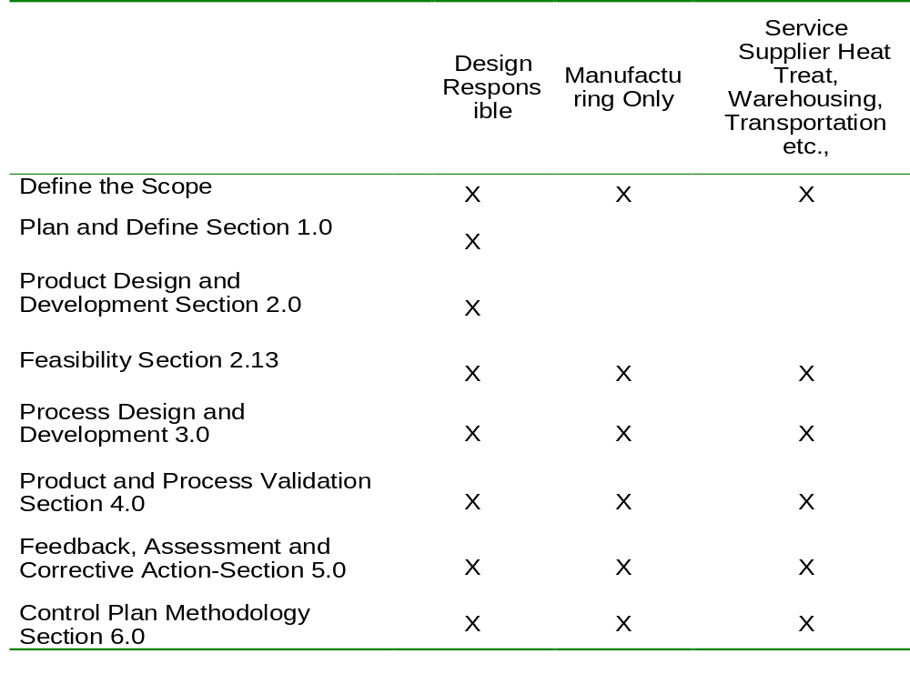
THE PRODUCT QUALITY PLANNING RESPONSIBILITY MATRIX
RESPONSIBILITY MATRIX

Slide 9
The product quality planning team’s first effort should be the development of a timing plan. This timing plan should list all tasks with responsibility and target dates. It is a good practice to follow the project management techniques like Gantt Chart, Critical Path Method, PERT etc. This plan can be regularly reviewed and updated as the planning evolves.
PRODUCT QUALITY TIMING PLAN

Slide 10
OBJECTIVES
Determine customer needs
Plan a quality program (which includes Scope, Time, Budget, etc.)
INPUTS
    Voice of the customer - For Vehicle to be done by Mkt Research
      market research - For Auto Component not required.
      historical warranty and quality information - by QA / QC
      team experience
    Business plan/marketing strategy - by Mktg dept (Quality data)
    Product/process benchmark data - by Mktg / Purchase (Tech Data)
    Product/process assumptions -
    Product reliability - If applicable for type of product otherwise skip - by customer
    Customer inputs - Project Manager under Mktg dept
PLAN AND DEFINE PROGRAM

Slide 11
OUTPUTS
    Design goals - provided if responsible for design and for Auto comp division, can be skipped.
    Reliability and quality goals - by QC head
    Preliminary bill of material - by design
    Preliminary process flow chart - by all concerned
    Preliminary listing of special product and process characteristics - by all team members
    Product assurance plan
    Management support - Team leader to co-ordinate for Mgmt review.
PLAN AND DEFINE PROGRAM

Slide 12
OBJECTIVES
    Develop design features and characteristic
    Critically review engineering requirements
    Assess potential manufacturing problems
INPUTS
    Design goals
    Reliability and quality goals
    Preliminary process flow chart
    Preliminary listing of special product and process characteristics
    Product assurance plan
    Customer requirement ( special ch., identification, traceability,etc)
    Use of information
    Targets for product quality, life, reliability, durability, maintainability, timing and cost )
    Management support
PRODUCT DESIGN & DEVELOPMENT

Slide 13
    OUTPUTS BY DESIGN RESPONSIBLE ACTIVITY
    Design failure mode and effects analysis(DFMEA) - CFT (MDT)
    Design for manufacturing and assembly (DFM & DFA)
    Design verification - Design
    Design reviews - CFT
    Prototype build – control plan
    Engineering drawings (including math data)
    Engineering specifications Design
    Material specification
    Drawing and specification changes
    Product special characteristics
    Product error proofing as appropriate - Product / process design
    Product definition - by design
    Diagnostic guidelines where applicable - by design
PRODUCT DESIGN & DEVELOPMENT

Slide 14
    OUTPUTS BY PRODUCT QUALITY PLANNING TEAM (CFT)
    New equipment tooling and facilities requirements - by process planning
    Special product and process characteristics - QA and PE
    Gages/testing equipment requirement - External lab to be accredited to ISO / IEC / 17025
    Team feasibility commitment and management support
PRODUCT DESIGN & DEVELOPMENT

Slide 15
OBJECTIVES
    Develop a comprehensive and effective manufacturing system
    Ensure that the manufacturing systems meets customer requirements.
PROCESS DESIGN & DEVELOPMENT

Slide 16
INPUTS
    Design Output data
    Targets for productivity, process capability and cost
    Customer requirements if any
    Experience from previous developments
    Design failure mode and effect analysis (DFMEA)
    Design for manufacturibility and assembly
    Design verification
    Design reviews
    Prototype build-control plan
    Engineering drawings (including math data)
    Engineering specifications
    Material specifications
    Drawing and specification changes
    New equipment tooling and facilities requirements
    Special product and process characteristics
    Gages/testing equipment requirement
    Team feasibility commitment and management support
PROCESS DESIGN & DEVELOPMENT

Slide 17
OUTPUTS
    Packaging standards - by Mktg
    specifications and drawings - by Process planning & tool design
    Product process quality system review - by MR
    Process flow chart - by Process planning
    Floor plan layout - by IED
    Process approval acceptance criteria - by process planning (RHC)
    Data for quality, reliability, maintainability and measurability - for Quality and measurability by QA, for reliability by IED and for maintainability by Maint
    Results of error proofing activities - Plant Engg.
    Methods of rapid detection and feedback of product/manufacturing process non conformities - Quality
    Characteristics matrix - Process planning
    Process failure mode and effects analysis (PFMEA) - CFT
    Pre-launch control plan - CFT
    Process instruction - Process planning
    Measurement systems analysis plan - QA
    Preliminary process capability study plan - QA and production
    Packaging specification
    Management support
PROCESS DESIGN & DEVELOPMENT

Slide 18
OBJECTIVES
    Validate the manufacturing process & the product
    Ensure that customer’s expectations will be met
    Identify additional concerns
PRODUCT & PROCESS VALIDATION

Slide 19
INPUTS
    Packaging standards
    Product process quality system review
    Process flow chart
    Floor plan layout
    Characteristics matrix
    Process Failure Mode and Effects Analysis (PFMEA)
    Pre-launch control plan
    Process instruction
    Measurement Systems Analysis Plan
    Preliminary process capability study plan
    Packaging specification
    Process approval acceptance criteria
    Data for Quality, reliability, maintainability and measurability
    Results of error proofing activities, as appropriate
    Methods of rapid detection and feedback of product/manufacturing process nonconformities.
    Management support
PRODUCT & PROCESS VALIDATION

Slide 20
OUTPUTS
    Production trial run - Production + P. planning + team leader
    Measurement systems evaluation - QA
    Preliminary process capability study - QA (Process planning)
    Production part approval - CFT & submission by Mktg
    Production validation testing - QA
    Packaging evaluation - QA
    Production control plan - CFT
    Quality planning sign-off and management support - CFT
PRODUCT & PROCESS VALIDATION

Slide 21
OBJECTIVES
    Obtain objective feedback for future planning
    To plan the next phase of product development or modification
    To improve the system of planning (from lessons learnt)
    To identify opportunities for Improvement
INPUTS
    Production trial run
    Measurement systems evaluation
    Preliminary process capability study
    Production part approval
    Production validation testing
    Packaging evaluation
    Production control plan
    Quality planning sign-off and management support
FEEDBACK, ASSESSMENT & CA

Slide 22
OUTPUTS
    Reduced variation
    Customer satisfaction
    Delivery and service
FEEDBACK, ASSESSMENT & CA

Slide 23
TEAM LEADER
Each program has a team leader, but a team leader may manage one or more programs. The team leader:
    is typically a senior Production or Quality Manager
    interfaces with the customer
    ensures that the Program Need Dates (PND) are met
    is responsible for resources and organisation
    is responsible until product launch
    forms and manages one or more APQP Teams
PROGRAM MANAGEMENT

Slide 24
APQP TEAMS
Team Composition
    Team should be cross-functional; it is not composed of only people from the Quality Department. Typical members might come from:
      Engineering
      Manufacturing
      Material Control
      Purchasing
      Sales
      Field Service
      Subcontractors
      Quality
      Industrial Engineering
      Maintenance
      Customers(as appropriate)
      Finance
PROGRAM MANAGEMENT

Slide 25
Team Responsibilities
    Success of the Product Quality Planning Team is dependent upon the interest, commitment, support and direction of upper management. The APQP team:
      is the Product launch Steering Committee responsible for quality planning
      works with the programme manager establish PNDs
      determines the extent of require APQP activities
      determines initial risk assessments and feasibility requirements (time related, delivery related and cost related)
      demonstrates that all planning requirements have been met
      ensures that concerns have been documented and scheduled for resolution
    Overall, through this process, the team initiates the building of a Culture of Simultaneous Engineering in the Organisation.
PROGRAM MANAGEMENT

